Slide 1






Data Visualization NASA Astronauts 1959-2013
Edgardo Panza
Lucas Whitmire
Federico Rueda Luna
Master of Data Science – SoSe 2020

Slide 2
Agenda
Introduction to Dataset (1 min.)
Stages in Exploratory Analysis (collection-process-cleansing-communicate)
Develop Approach 1 (4 min.)
Develop Approach 2 (4 min.)
Develop Approach 3 (4 min.)
Key Findings on Dataset (1 min.)
Conclusions from process (1 min.)
2
Notes:
Total time: 20 mins.
Erase the time in each bullet point

Slide 3
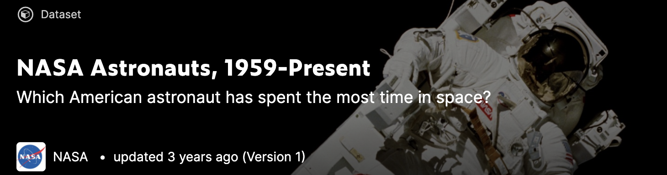
Introduction to Dataset
Data Contains Information about 50 years of NASA Astronauts (1959-2009)
Gender, Induction Year, Education, Military Service, Missions, Time in Space, Time in Spacewalk
357 Astronauts
Questions to be answered:
Historically, what’s the path to becoming an Astronaut?
How has this path changed over time?
3

Slide 4
Career of women in space
Let’s start with the proportion of male/female NASA astronauts from 1959 to 2013:
Speech …
4
Notes:
4

Slide 5
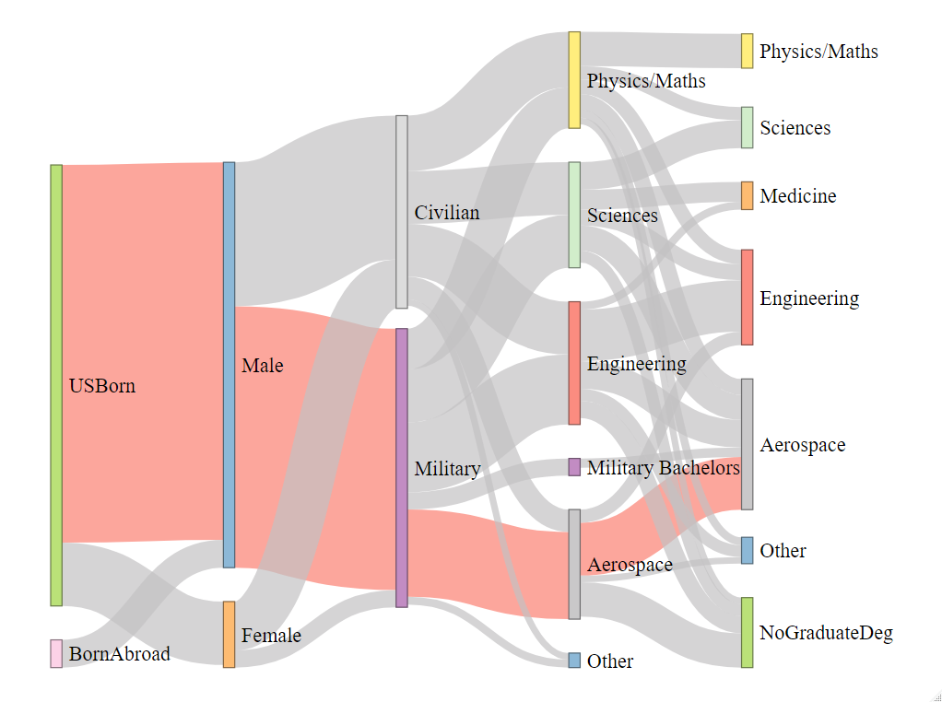
How to become an Astronaut?
5
Notes:
Path of least resistance presented in red.
Significant data cleaning was required for both Undergrad and Grad degrees (83 Under, 143 Grad)
Talk about breakout of aerospace from engineering/sciences/physics.
Links with values < 4 were removed for clarity.
5

Slide 6
CONCLUSIONS
Part 1:
Info…
6
Notes:
6

Slide 7
QUESTIONS?
THANKS!
7
Notes:
7

